Slide 1
Coding PL/SQL Triggers
Notes:
Schedule: Timing Topic
<xx> minutes Lecture
<xx> minutes Practice
<xx> minutes Total

Slide 2
Objectives
  After completing this lesson, you should be able to
  do the following:
  Describe the different types of triggers
  Describe sample uses of triggers
  Write and reference common code
  Create a PL/SQL library
  Publish a report as a result of a database event
Notes:
Lesson Aim
<Enter lesson aim here.>

Slide 3
Types of Triggers in Reports
  Report:
    Five triggers
    Report Triggers node in Object Navigator
  Data Model:
    Formula (column)
    Filter (group)
    Parameter validation
  Layout: Format trigger on most objects

Slide 4
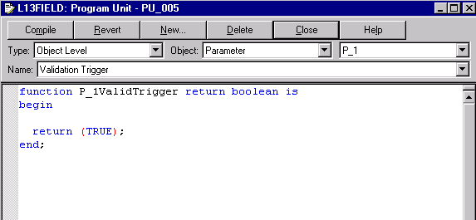
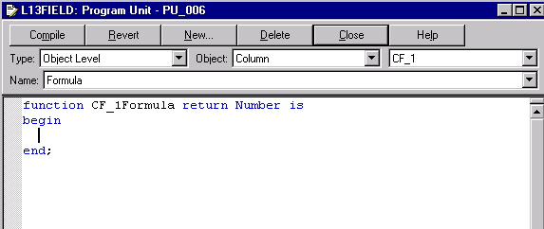
Trigger Code
Boolean:
true
false
Character
Number
Date

Slide 5
Using Report Triggers
Before
Parameter
Form
F
1
2
If readonly=yes
3
F
If > 1 page
After
Parameter
Form
Before
Report
Between
Pages
After
Report
page1
page2
F
F

Slide 6
Using Report Triggers
  After Parameter Form
    Example: Build dynamic WHERE clause
  Query syntax
FUNCTION AfterPForm RETURN BOOLEAN IS
BEGIN
IF :p_customer IS NULL THEN
:p_where_clause := ' ';
ELSE
:p_where_clause := 'where id >= :p_customer';
END IF;
RETURN(TRUE);
END;
SELECT CUSTOMER_ID, CUSTOMER_NAME
FROM CUSTOMERS
ORDER BY CUSTOMER_NAME
&p_where_clause

Slide 7
Using Data Model Triggers
  Group Filter
  Restrict records in a group
  Perform PL/SQL for each record
  PL/SQL filters result in all records being fetched
FUNCTION G_empGroupFilter RETURN BOOLEAN IS
BEGIN
IF :department_name = 'Operations' AND
:salary > 5000 THEN
RETURN(my_function);
ELSE
RETURN(TRUE);
END IF;
END;

Slide 8
Using Data Model Triggers
  Parameter Validation
  Example: Do not allow report output to be sent directly to a printer.
  You cannot reassign values to parameters or columns in this trigger.
FUNCTION DESTYPEValidTrigger RETURN BOOLEAN IS
BEGIN
IF :DESTYPE = 'Printer' THEN
RETURN(FALSE);
ELSE
RETURN(TRUE);
END IF;
END;

Slide 9
Using Layout Triggers
  Format triggers:
  Exist on most layout objects
  Can suppress an entire layout section (master group frame): No records fetched
  Can suppress the display of individual records (repeating frame): All records fetched

Slide 10
Displaying a Text String in Place of Column Headings
Dept: 10
Dept:
f_deptno
Name Salary
Name Salary
1
No employees in
this department
Dept: 40
No employees in
this department
2

Slide 11
Dynamically Altering the Display of Records
Employee Details
Employee Details
King 17-JUN-87 24000
f_name f_date f_salary
Kochhar 21-SEP-89 17000
De Haan 13-JAN-93 17000
Employee Details
f_name f_date
King 17-JUN-87
Kochhar 21-SEP-89
2
De Haan 13-JAN-93
1
3

Slide 12
Dynamically Hiding Fields
Employee Details
Employee Details
King 17-JUN-87 24000
1
f_name f_date f_salary
Kochhar 21-SEP-89 17000
De Haan 13-JAN-93 17000
Employee Details
King 17-JUN-87
Kochhar 21-SEP-89
De Haan 13-JAN-93
2

Slide 13
Using a Format Trigger in a Web Layout
<tbody> <rw:foreach id="R_G_DEPARTMENT_ID_1"
src="G_DEPARTMENT_ID">
<tr>
…
<td
<rw:headers id="HFSALARY" src="HBSALARY"/>
class="OraCellNumber">
<rw:field id="F_SALARY" src="SALARY"
nullValue="&nbsp;"
formatMask="$999,999.00" formatTrigger="mystyles"> F_SALARY
</rw:field>
</td>
…
</tr>
</rw:foreach> </tbody>

Slide 14
Inserting Spacing Between Groups of Records
f_1
f_2
f_3
1
2
3
4
FUNCTION spacing RETURN BOOLEAN IS
BEGIN
IF MOD(:count_column, 3) = 0 THEN
RETURN(TRUE);
ELSE
RETURN(FALSE);
END IF;
END;

Slide 15
Writing Common Code
  At the Report level:
  Object Navigator, Program Units
  Menu: Program > PL/SQL Editor
  In a library:
  Object Navigator, PL/SQL Library
  File > New: Create new library
  File > Open: Add to existing library
  Attach library to report

Slide 16
Event-Based Reporting
  Implemented through PL/SQL stored procedures
  Uses include:
    Running a report
    Displaying report status
    Canceling a report
    Managing parameter lists

Slide 17



Event-Based Reporting
PL/SQL
Oracle
Workflow
Advanced
Queuing
Output
Data
model
Data
interface
Client
Reports Services
Reports
Cache
E-mail
Printer
File

Slide 18
Invoking a Report from a Database Event
  Create a database trigger
  Include a parameter list with the required entries:
    GATEWAY
    SERVER
    REPORT
    USERID

Slide 19
Summary
  In this lesson, you should have learned how to:
  Select the appropriate trigger type for your requirement: Report, Data Model, or Layout
  Identify the trigger and code needed for:
    Building a dynamic WHERE clause
    Validating a parameter value
    Dynamically altering record display
    Suppressing null fields
  Use Report-level program units and create PL/SQL libraries for common code
  Invoke a report from a database event

Slide 20
Practice 19 Overview
  Creating a format trigger to display different paper layouts conditionally
  Creating and using a report-level PL/SQL function
  Creating an using an external PL/SQL library
  Creating a PL/SQL group filter

